Slide 1
Deeshna CK Tools Used: SQL, Tableau
Cyclistic Bike Share Analysis
Google Data Analytics Capstone Project

Slide 2
Business Problem
• Cyclistic wants to convert casual riders into annual members.
• Analyze riding behavior between member and casual users.
• Identify trends based on weekdays and monthly ride activity.
• Provide business recommendations to improve membership growth.

Slide 3
Data Cleaning & Preparation
• Removed duplicate records and invalid ride entries.
• Handled missing values and incorrect timestamps.
• Created weekday and ride duration metrics.
• Standardized user categories and date formats.
• Prepared clean dataset for Tableau dashboarding.

Slide 4
Key KPIs Tracked
• Total rides by customer type.
• Monthly and weekday ride trends.
• Member vs casual contribution analysis.
• Seasonal demand patterns.
• Customer usage behavior insights.

Slide 5
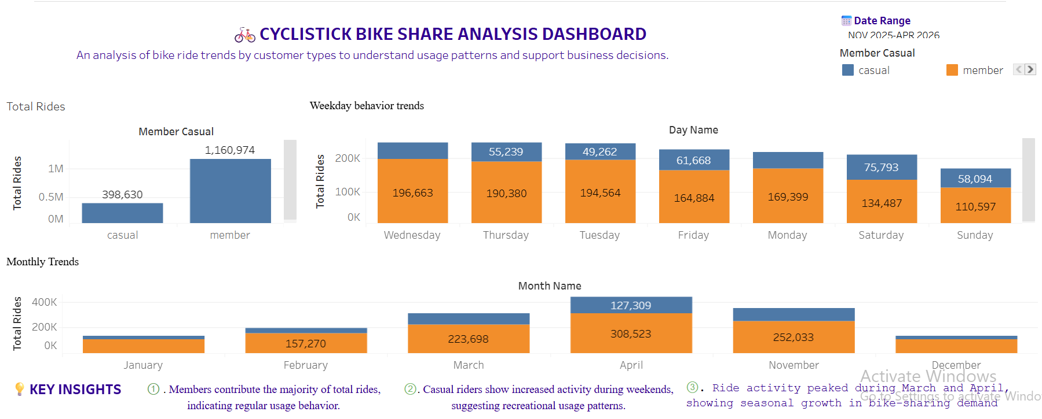
Interactive Tableau Dashboard

Slide 6
Key Insights
• Members contribute the majority of overall rides.
• Casual riders are more active during weekends.
• Ride activity peaks during March and April.
• Members show more consistent weekday usage.
• Seasonal demand significantly impacts bike-sharing activity.

Slide 7
Business Recommendations
• Launch weekend-focused membership campaigns.
• Offer seasonal discounts for casual riders.
• Use loyalty programs to increase retention.
• Target frequent casual users with personalized marketing.

Slide 8
Conclusion
The analysis identified clear behavioral differences between member
and casual riders. These insights can help Cyclistic improve customer
targeting strategies and increase annual memberships.

